Slide 1

Network+ Guide to Networks 6th Edition
Chapter 7
Wide Area Networks

Slide 2
Objectives
Identify a variety of uses for WANs
Explain different WAN topologies, including their advantages and disadvantages
Compare the characteristics of WAN technologies, including their switching type, throughput, media, security, and reliability
Describe several WAN transmission and connection methods, including PSTN, ISDN, T-carriers, DSL, broadband cable, broadband over powerline, ATM, and SONET

Slide 3
WAN Essentials
WAN
Network traversing some distance, connecting LANs
Transmission methods depend on business needs
WAN and LAN common properties
Client-host resource sharing
Layer 3 and higher protocols
Packet-switched digitized data

Slide 4
WAN Essentials (cont’d.)
WAN and LAN differences
Layers 1 and 2 access methods, topologies, media
LAN wiring: privately owned
WAN wiring: public through NSPs (network service providers)
Examples: AT&T, Verizon, Sprint
WAN site
Individual geographic locations connected by WAN
WAN link
WAN site to WAN site connection

Slide 5
WAN Topologies
Differences from LAN topologies
Distance covered, number of users, traffic
Connect sites via dedicated, high-speed links
Use different connectivity devices
WAN connections
Require Layer 3 devices
Routers
Cannot carry nonroutable protocols

Slide 6
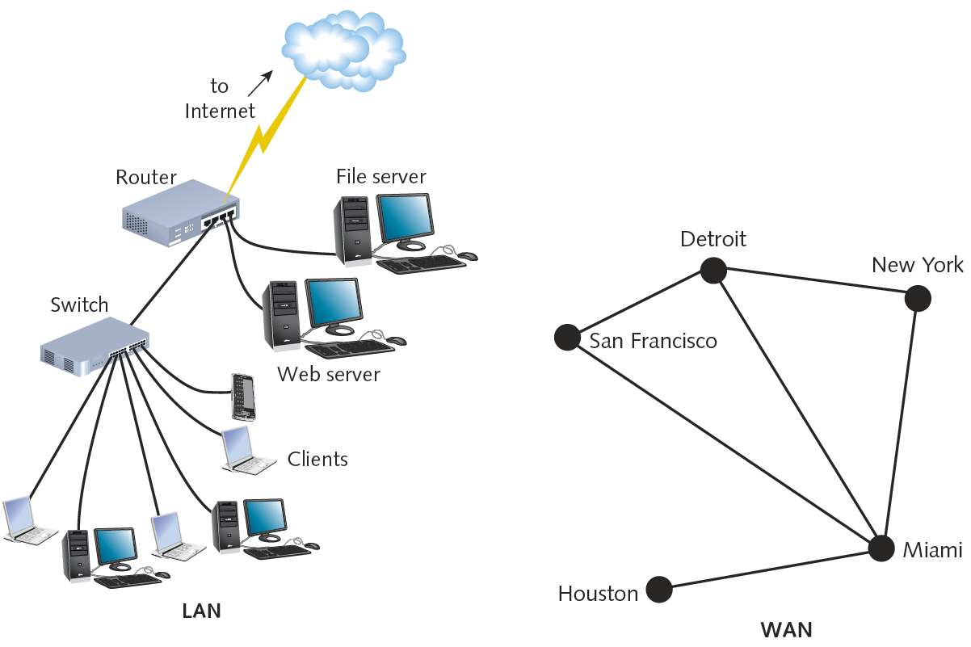
Figure 7-1 Differences in LAN and WAN connectivity
Courtesy Course Technology/Cengage Learning

Slide 7
Bus
Bus topology WAN
Each site connects serially to two sites maximum
Network site dependent on every other site to transmit and receive traffic
Different locations connected to another through point-to-point links
Best use
Organizations requiring small WAN, dedicated circuits
Drawback
Not scalable

Slide 8
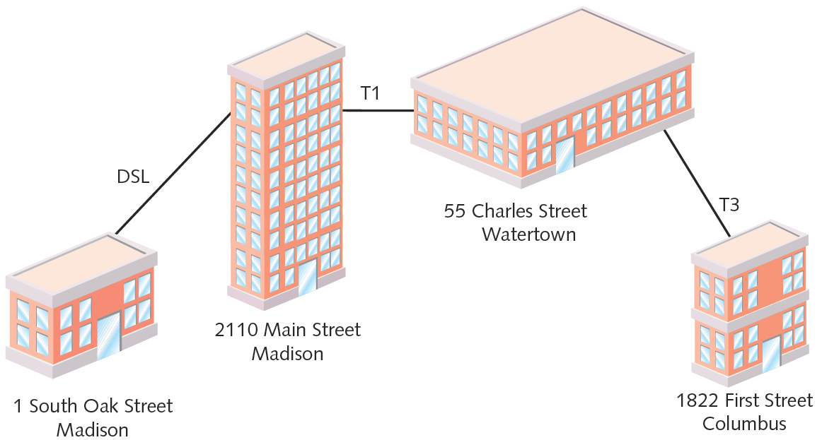
Figure 7-2 A bus topology WAN
Courtesy Course Technology/Cengage Learning

Slide 9
Ring
Ring topology WAN
Each site connected to two other sites
Forms ring pattern
Connects locations
Relies on redundant rings
Data rerouted upon site failure
Expansion
Difficult, expensive
Best use
Connecting maximum five locations

Slide 10
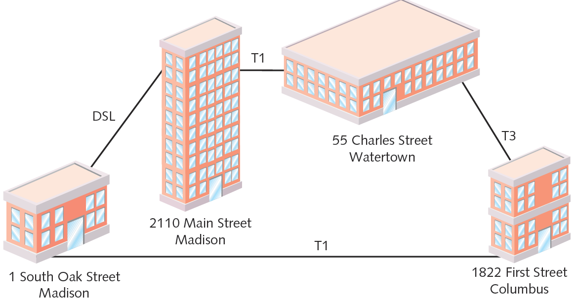
Figure 7-3 A ring topology WAN
Courtesy Course Technology/Cengage Learning

Slide 11
Star
Star topology WAN
Single site central connection point
Separate data routes between any two sites
Advantages
Single connection failure affects one location
Shorter data paths between any two sites
Expansion: simple, less costly
Drawback
Central site failure can bring down entire WAN

Slide 12
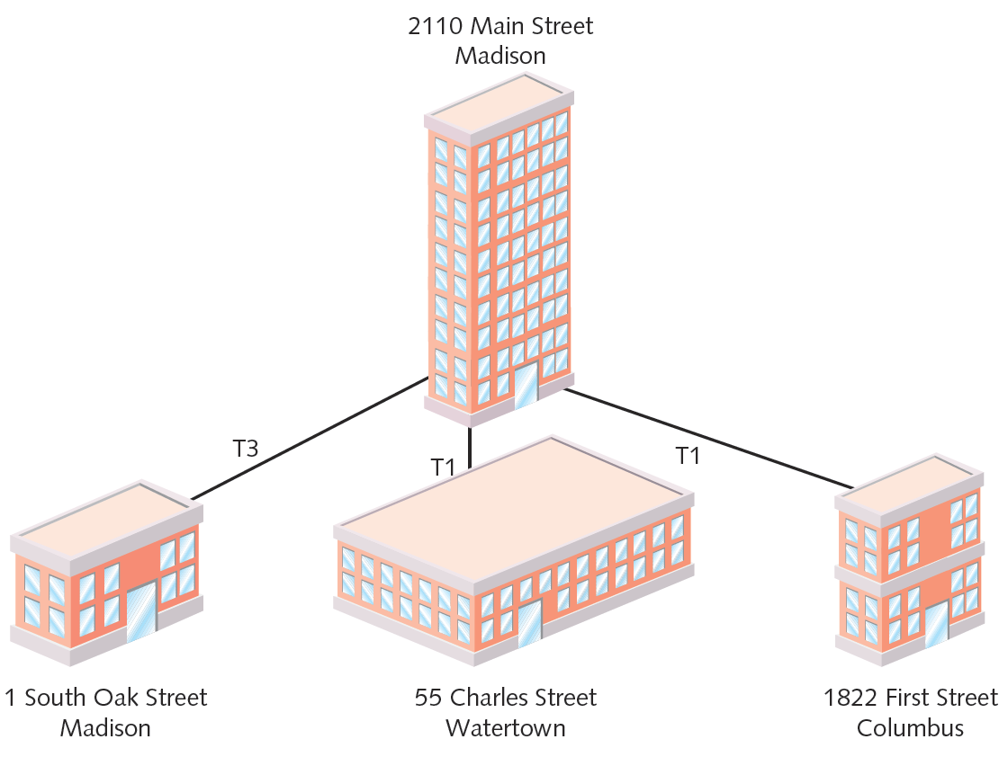
Figure 7-4 A star topology WAN
Courtesy Course Technology/Cengage Learning

Slide 13
Mesh
Mesh topology WAN
Incorporates many directly interconnected sites
Data travels directly from origin to destination
Routers can redirect data easily, quickly
Most fault-tolerant WAN type
Full-mesh WAN
Every WAN site directly connected to every other site
Drawback: cost
Partial-mesh WAN
Less costly

Slide 14
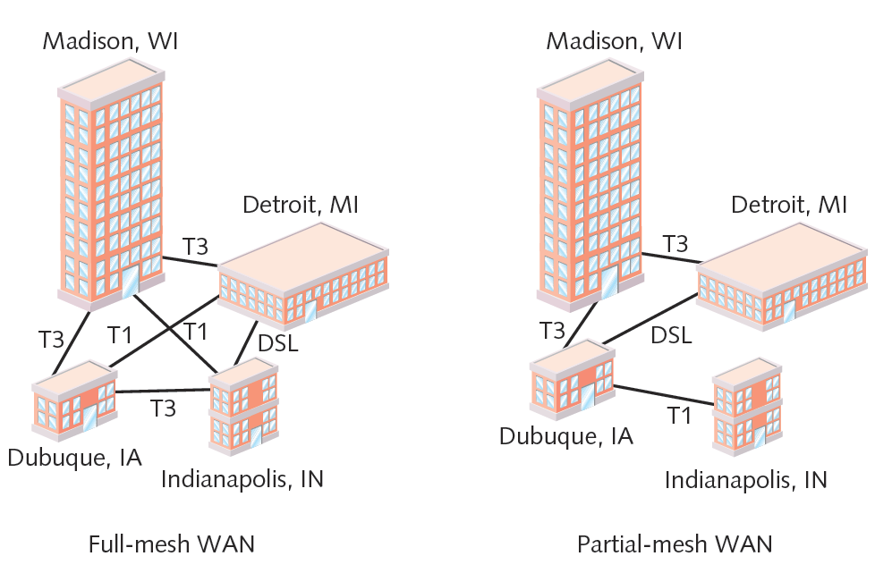
Figure 7-5 Full-mesh and partial-mesh WANs
Courtesy Course Technology/Cengage Learning

Slide 15
Tiered
Tiered topology WAN
Sites connected in star or ring formations
Interconnected at different levels
Interconnection points organized into layers
Form hierarchical groupings
Flexibility
Allows many variations, practicality
Requires careful considerations
Geography, usage patterns, growth potential

Slide 16
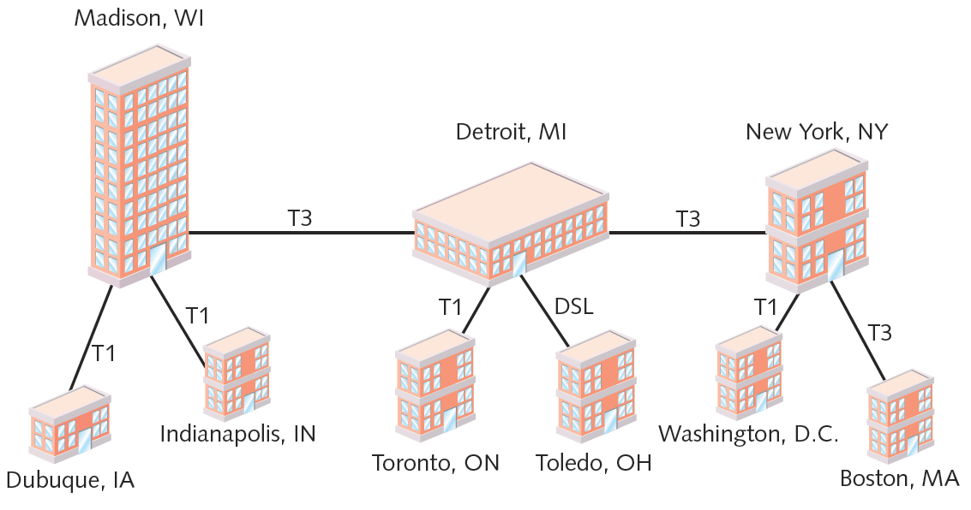
Figure 7-6 A tiered topology WAN
Courtesy Course Technology/Cengage Learning

Slide 17
PSTN
PSTN (Public Switched Telephone Network)
Network of lines, carrier equipment providing telephone service
POTS (plain old telephone service)
Encompasses entire telephone system
Originally: analog traffic
Today: digital data, computer controlled switching
Dial-up connection
Modem connects computer to distant network
Uses PSTN line

Slide 18
PSTN (cont’d.)
PSTN elements
Cannot handle digital transmission
Requires modem
Signal travels path between modems
Over carrier’s network
Includes CO (central office), remote switching facility
Signal converts back to digital pulses
CO (central office)
Where telephone company terminates lines
Switches calls between different locations

Slide 19
PSTN (cont’d.)
Local loop (last mile)
Portion connecting residence, business to nearest CO
May be digital or analog
Digital local loop
Fiber to the home (fiber to the premises)
Passive optical network (PON)
Carrier uses fiber-optic cabling to connect with multiple endpoints

Slide 20
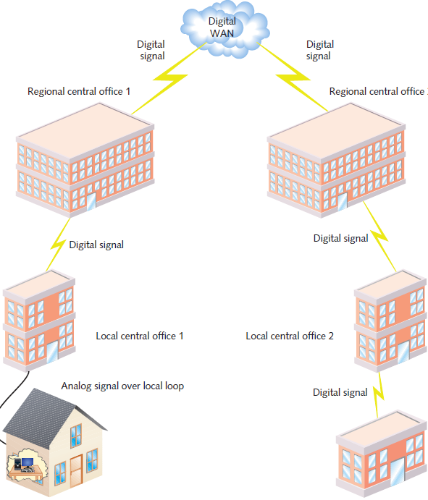
Figure 7-7 A long-distance dial-up connection
Courtesy Course Technology/Cengage Learning

Slide 21
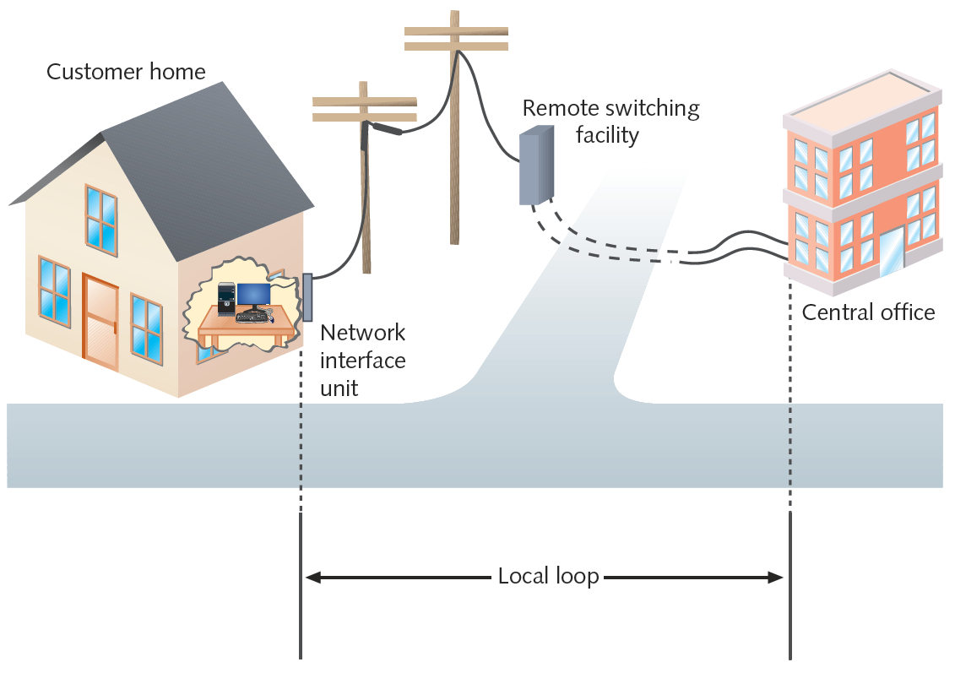
Figure 7-8 Local loop portion of the PSTN
Courtesy Course Technology/Cengage Learning

Slide 22
PSTN (cont’d.)
Optical line terminal
Single endpoint at carrier’s central office in a PON
Device with multiple optical ports
Optical network unit
Distributes signals to multiple endpoints using fiber-optic cable
Or copper or coax cable

Slide 23
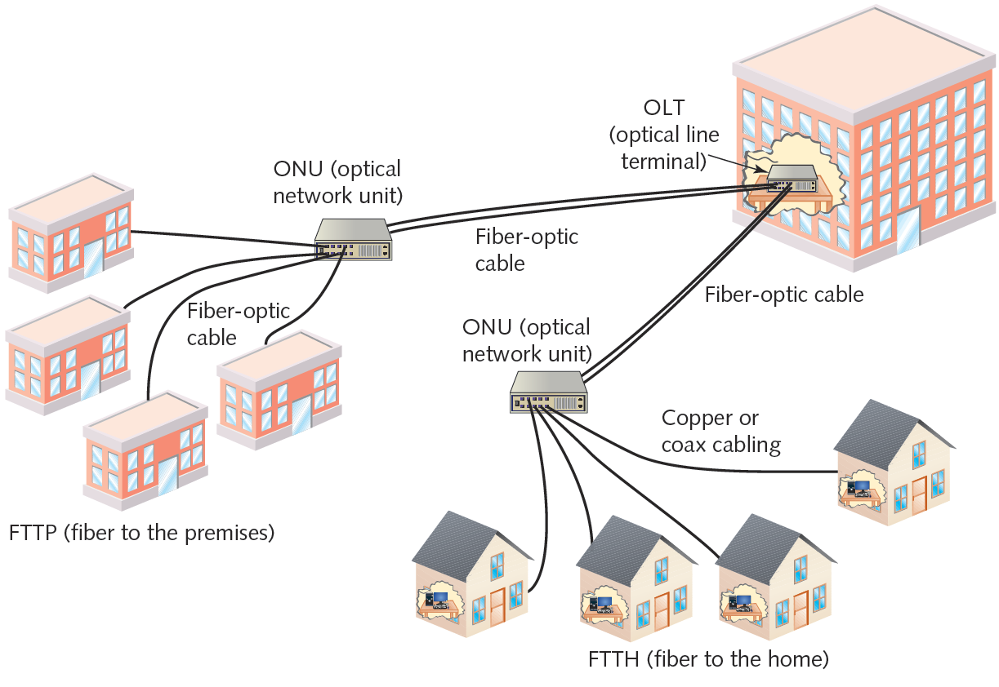
Figure 7-9 Passive optical network (PON)
Courtesy Course Technology/Cengage Learning

Slide 24
X.25 and Frame Relay
X.25 ITU standard
Analog, packet-switching technology
Designed for long distance
Original standard: mid 1970s
Mainframe to remote computers: 64 Kbps throughput
Update: 1992
2.048 Mbps throughput
Client, servers over WANs
Verifies transmission at every node
Excellent flow control, ensures data reliability
Slow, unreliable for time-sensitive applications

Slide 25
X.25 and Frame Relay (cont’d.)
Frame relay
Updated X.25: digital, packet-switching
Protocols operate at Data Link layer
Supports multiple Network, Transport layer protocols
Both perform error checking
Frame relay: no reliable data delivery guarantee
X.25: errors fixed or retransmitted
Throughput
X.25: 64 Kbps to 45 Mbps
Frame relay: customer chooses

Slide 26
X.25 and Frame Relay (cont’d.)
Both use virtual circuits
Node connections with disparate physical links
Logically appear direct
Advantage: efficient bandwidth use
Both configurable as SVCs (switched virtual circuits)
Connection established for transmission, terminated when complete
Both configurable as PVCs (permanent virtual circuits)
Connection established before transmission, remains after transmission

Slide 27
X.25 and Frame Relay (cont’d.)
PVCs
Not dedicated, individual links
X.25 or frame relay lease contract
Specify endpoints, bandwidth
CIR (committed information rate)
Minimum bandwidth guaranteed by carrier
PVC lease
Share bandwidth with other X.25, frame relay users

Slide 28
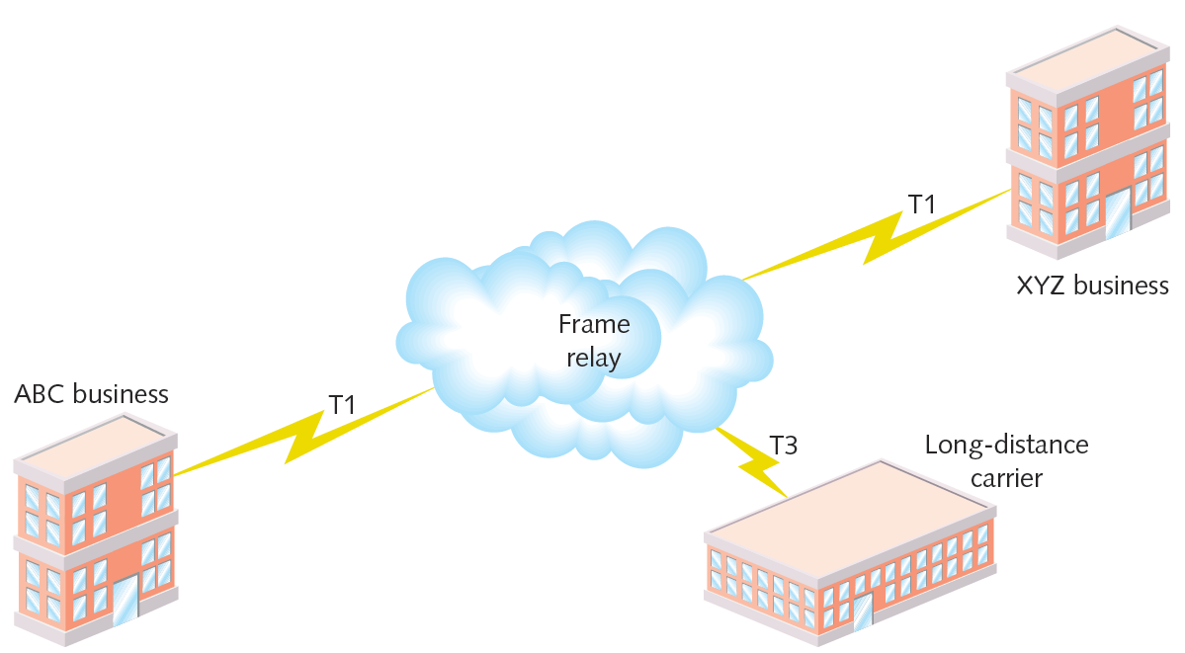
Figure 7-10 A WAN using frame relay
Courtesy Course Technology/Cengage Learning

Slide 29
X.25 and Frame Relay (cont’d.)
Frame relay lease advantage
Pay for bandwidth required
Less expensive technology
Long-established worldwide standard
Frame relay and X.25 disadvantage
Throughput variability on shared lines
Frame relay and X.25 easily upgrade to T-carrier dedicated lines
Same connectivity equipment

Slide 30
ISDN
Standard for transmitting digital data over PSTN
Gained popularity: 1990s
Connecting WAN locations
Exchanges data, voice signals
Protocols at Physical, Data Link, Transport layers
Signaling, framing, connection setup and termination, routing, flow control, error detection and correction
Relies on PSTN for transmission medium
Dial-up or dedicated connections
Dial-up relies exclusively on digital transmission

Slide 31
ISDN (cont’d.)
Capability: two voice calls, one data connection on a single line
Two channel types
B channel: “bearer”
Circuit switching for voice, video, audio: 64 Kbps
D channel: “data”
Packet-switching for call information: 16 or 64 Kbps
BRI (Basic Rate Interface) connection
PRI (Primary Rate Interface) connection

Slide 32
ISDN (cont’d.)
BRI: two B channels, one D channel (2B+D)
B channels treated as separate connections
Carry voice and data
Bonding
Two 64-Kbps B channels combined
Achieve 128 Kbps
PRI: 23 B channels, one 64-Kbps D channel (23B+D)
Separate B channels independently carry voice, data
Maximum throughput: 1.544 Mbps
PRI and BRI may interconnect

Slide 33
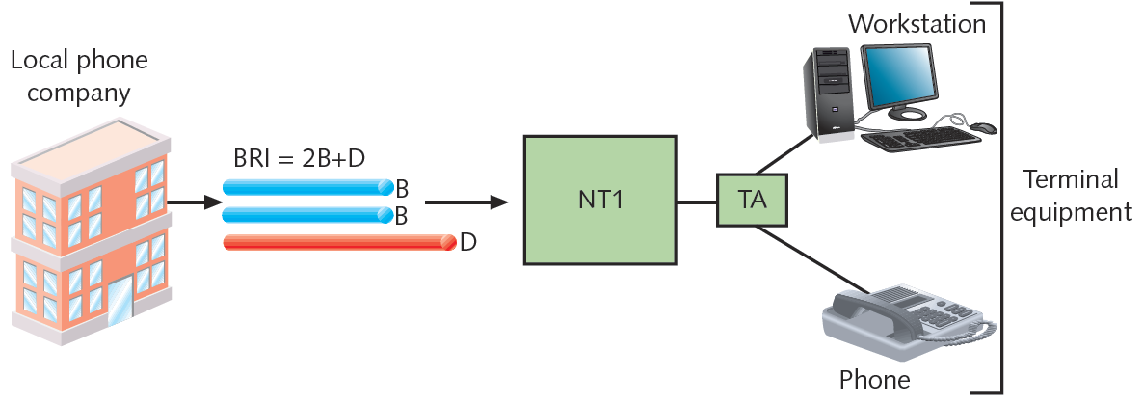
Figure 7-11 A BRI link
Courtesy Course Technology/Cengage Learning

Slide 34
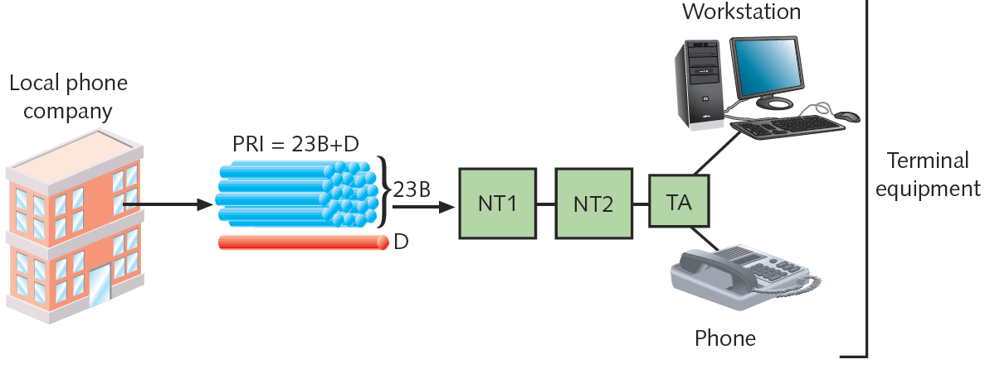
Figure 7-12 A PRI link
Courtesy Course Technology/Cengage Learning

Slide 35
T-Carriers
T1s, fractional T1s, T3s
Physical layer operation
Single channel divided into multiple channels
Uses TDM (time division multiplexing) over two wire pairs
Medium
Telephone wire, fiber-optic cable, wireless links

Slide 36
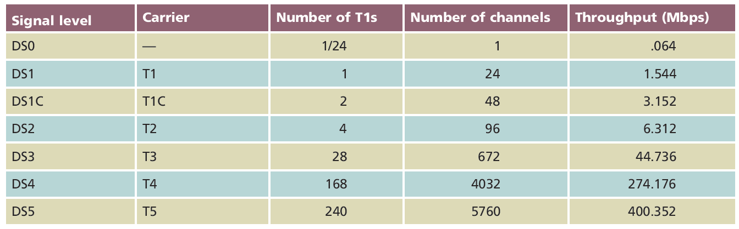
Types of T-Carriers
Many available
Most common: T1 and T3
Table 7-1 Carrier specifications
Courtesy Course Technology/Cengage Learning

Slide 37
Types of T-Carriers (cont’d.)
T1: 24 voice or data channels
Maximum data throughput: 1.544 Mbps
T3: 672 voice or data channels
Maximum data throughput: 44.736 Mbps (45 Mbps)
T-carrier speed dependent on signal level
Physical layer electrical signaling characteristics
DS0 (digital signal, level 0)
One data, voice channel

Slide 38
Types of T-Carriers (cont’d.)
T1 use
Connects branch offices, connects to carrier
Connects telephone company COs, ISPs
T3 use
Data-intensive businesses
T3 provides 28 times more throughput (expensive)
Multiple T1’s may accommodate needs
TI costs vary by region
Fractional T1 lease
Use some T1 channels, charged accordingly

Slide 39
T-Carrier Connectivity
T-carrier line requires connectivity hardware
Customer site, switching facility
Purchased or leased
Cannot be used with other WAN transmission methods
T-carrier line requires different media
Throughput dependent

Slide 40
T-Carrier Connectivity (cont’d.)
Wiring
Plain telephone wire
UTP or STP copper wiring
STP preferred for clean connection
Coaxial cable, microwave, fiber-optic cable
T1s using STP require repeater every 6000 feet
Multiple T1s or T3
Fiber-optic cabling

Slide 41
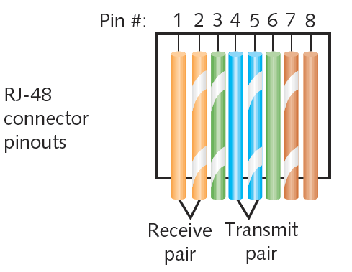
Figure 7-13 T1 wire terminations in an RJ-48 connector
Courtesy Course Technology/Cengage Learning

Slide 42
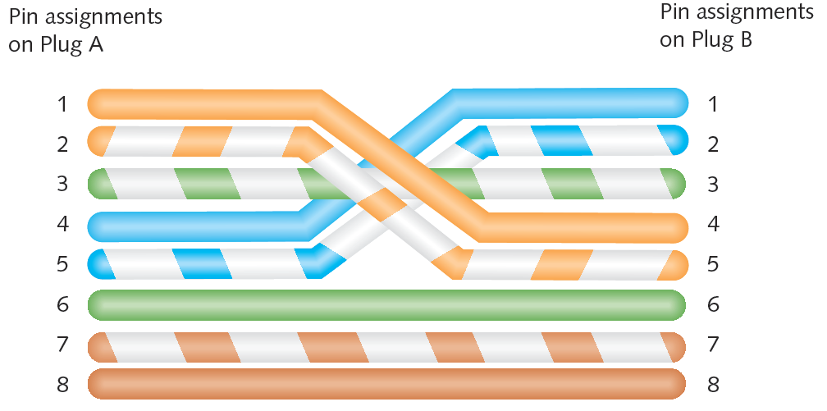
Figure 7-14 T1 crossover cable terminations
Courtesy Course Technology/Cengage Learning

Slide 43
T-Carrier Connectivity (cont’d.)
CSU/DSU (Channel Service Unit/Data Service Unit)
Two separate devices
Combined into single stand-alone device
Interface card
T1 line connection point
CSU
Provides digital signal termination
Ensures connection integrity

Slide 44
T-Carrier Connectivity (cont’d.)
DSU
Converts T-carrier frames into frames LAN can interpret (and vice versa)
Connects T-carrier lines with terminating equipment
Incorporates multiplexer
Smart jack
Terminate T-carrier wire pairs
Customer’s demarc (demarcation point)
Inside or outside building
Connection monitoring point

Slide 45
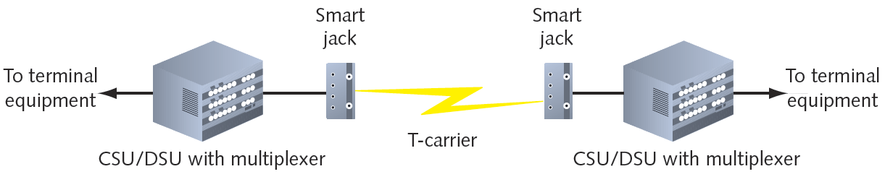
Figure 7-17 A point-to-point T-carrier connection
Courtesy Course Technology/Cengage Learning

Slide 46
T-Carrier Connectivity (cont’d.)
Incoming T-carrier line
Multiplexer separates combined channels
Outgoing T-carrier line
Multiplexer combines multiple LAN signals
Terminal equipment
Switches, routers
Best option: router, Layer 3 or higher switch
Accepts incoming CSU/DSU signals
Translates Network layer protocols
Directs data to destination

Slide 47
T-Carrier Connectivity (cont’d.)
CSU/DSU may be integrated with router, switch
Expansion card
Faster signal processing, better performance
Less expensive, lower maintenance solution

Slide 48
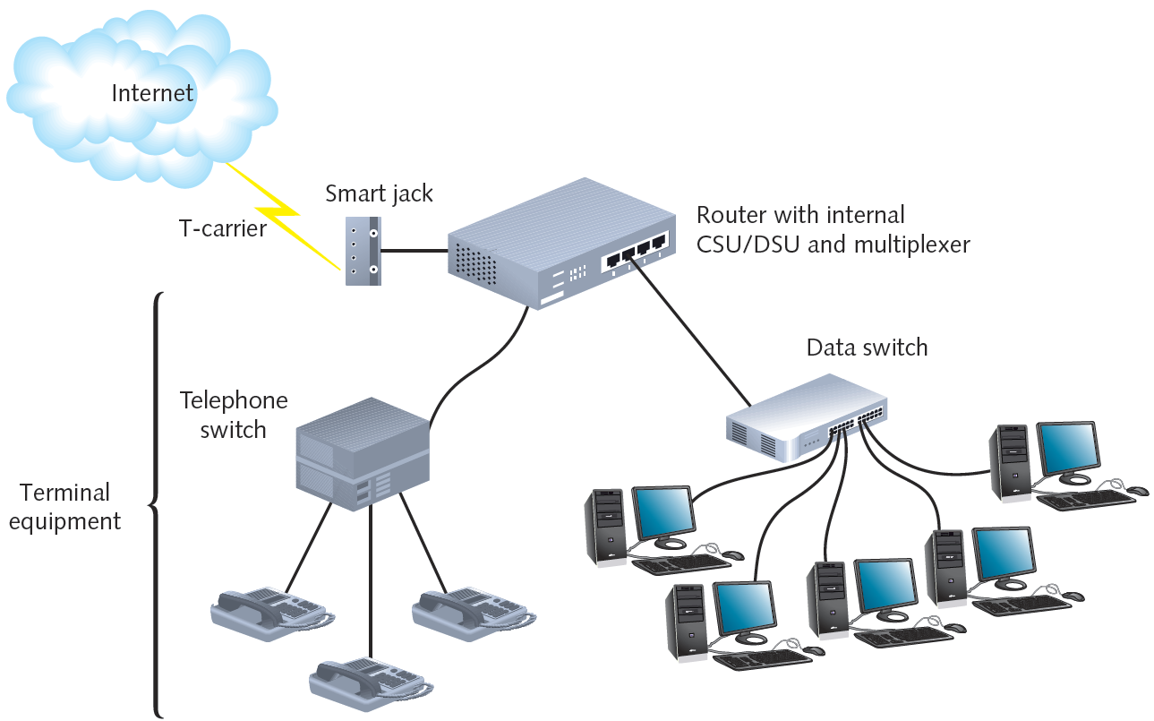
Figure 7-18 A T-carrier connecting to a LAN through a router
Courtesy Course Technology/Cengage Learning

Slide 49
DSL (Digital Subscriber Line)
Operates over PSTN
Directly competes with ISDN, T1 services
Requires repeaters for longer distances
Best suited for WAN local loop
Supports multiple data, voice channels
Over single line
Higher, inaudible telephone line frequencies
Uses advanced data modulation techniques
Data signal alters carrier signal properties
Amplitude or phase modulation

Slide 50
Types of DSL
xDSL refers to all DSL varieties
ADSL, G.Lite, HDSL, SDSL, VDSL, SHDSL
Two DSL categories
Asymmetrical and symmetrical
Downstream
Data travels from carrier’s switching facility to customer
Upstream
Data travels from customer to carrier’s switching facility

Slide 51
Types of DSL (cont’d.)
Downstream, upstream throughput rates may differ
Asymmetrical
More throughput in one direction
Downstream throughput higher than upstream throughput
Best use: video conferencing, web surfing
Symmetrical
Equal capacity for upstream, downstream data
Examples: HDSL, SDSL, SHDSL
Best use: uploading, downloading significant data amounts

Slide 52
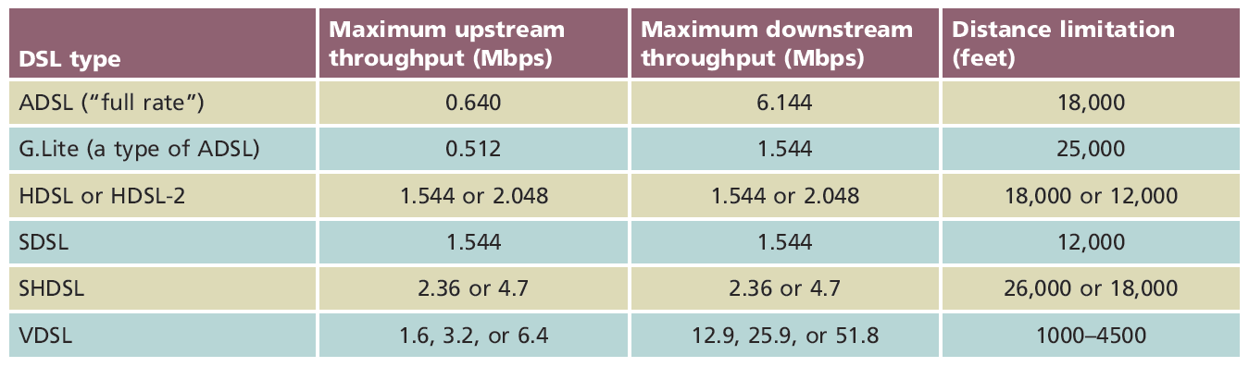
Types of DSL (cont’d.)
DSL types vary
Data modulation techniques
Capacity
Distance limitations
PSTN use
Table 7-2 Comparison of DSL types
Courtesy Course Technology/Cengage Learning

Slide 53
DSL Connectivity
ADSL: common example on home computer
Establish TCP connection
Transmit through DSL modem
Internal or external
Splitter separates incoming voice, data signals
May connect to switch or router

Slide 54
DSL Connectivity (cont’d.)
ADSL (cont’d.)
DSL modem forwards modulated signal to local loop
Signal continues over four-pair UTP wire
Distance less than 18,000 feet: signal combined with other modulated signals in telephone switch
Carrier’s remote switching facility
Splitter separates data signal from voice signals
Request sent to DSLAM (DSL access multiplexer)
Request issued from carrier’s network to Internet backbone

Slide 55
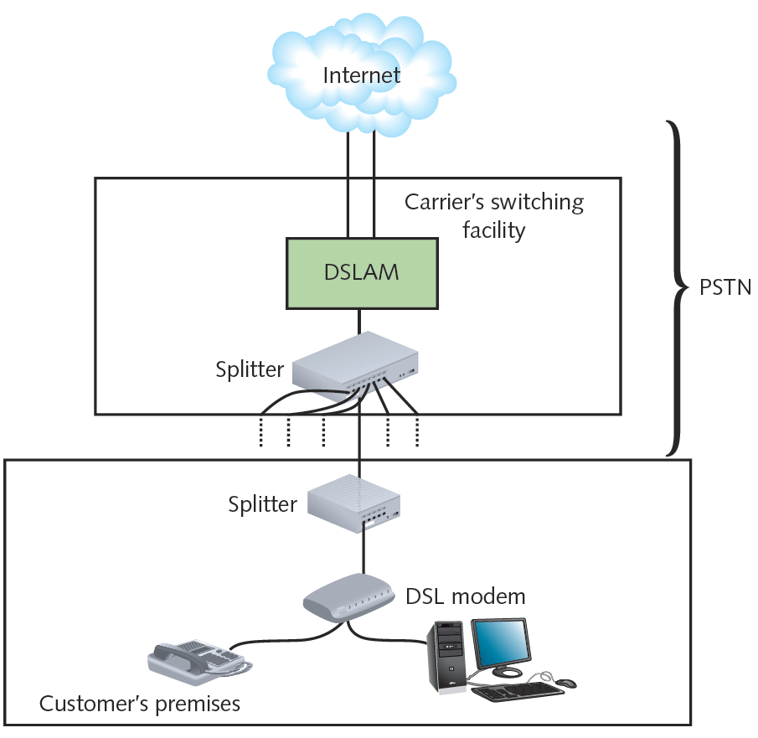
Figure 7-20 A DSL connection
Courtesy Course Technology/Cengage Learning

Slide 56
DSL Connectivity (cont’d.)
DSL competition
T1, ISDN, broadband cable
DSL installation
Hardware, monthly access costs
Slightly less than ISDN; significantly less than T1s
DSL drawbacks
Throughput lower than broadband cable

Slide 57
Broadband Cable
Cable companies connectivity option
Based on TV signals coaxial cable wiring
Theoretical transmission speeds
150 Mbps downstream; 10 Mbps upstream
Real transmission
10 Mbps downstream; 2 Mbps upstream
Transmission limited ( throttled)
Shared physical connections
Best uses
Web surfing
Network data download

Slide 58
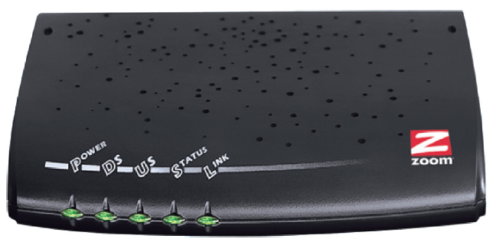
Broadband Cable (cont’d.)
Cable modem
Modulates, demodulates transmission, reception signals via cable wiring
Operates at Physical and Data Link layer
May connect to connectivity device
Figure 7-21 A cable modem
Courtesy Zoom Telephonics, Inc.

Slide 59
Broadband Cable (cont’d.)
Infrastructure required
HFC (hybrid fiber-coax)
Expensive fiber-optic link supporting high frequencies
Connects cable company’s offices to node
Cable drop
Connects node to customer’s business or residence
Fiber-optic or coaxial cable
Connects to head end
Provides dedicated connection
Many subscribers share same local line, throughput

Slide 60
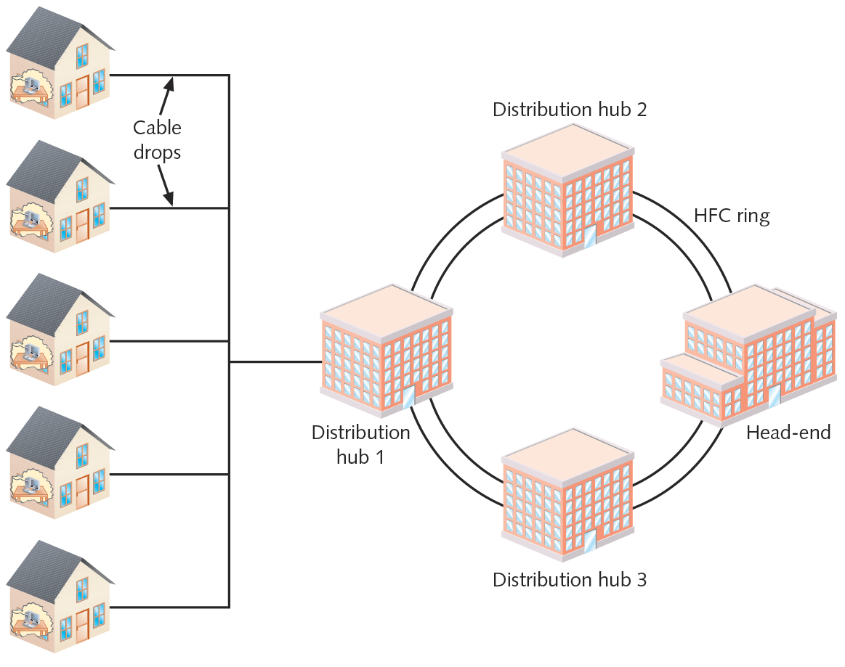
Figure 7-22 Cable infrastructure
Courtesy Course Technology/Cengage Learning

Slide 61
BPL (Broadband Over Powerline)
High-speed Internet access over the electrical grid
Began around 2000
Advantages
Potential for reaching remote users
Roadblocks to development
Opposition from telecommunications groups
Costly infrastructure upgrades
Signals subject to more noise than DSL, cable
Signals interfere with amateur radio

Slide 62
ATM (Asynchronous Transfer Mode)
Functions in Data Link layer
Asynchronous communications method
Nodes do not conform to predetermined schemes
Specifying data transmissions timing
Each character transmitted
Start and stop bits
Specifies Data Link layer framing techniques
Fixed packet size
Packet (cell)
48 data bytes plus 5-byte header

Slide 63
ATM (cont’d.)
Smaller packet size requires more overhead
Decrease potential throughput
Cell efficiency compensates for loss
ATM relies on virtual circuits
ATM considered packet-switching technology
Virtual circuits provide circuit switching advantage
Reliable connection
Allows specific QoS (quality of service) guarantee
Important for time-sensitive applications

Slide 64
ATM (cont’d.)
Compatibility
Other leading network technologies
Cells support multiple higher-layer protocol
LANE (LAN Emulation)
Allows integration with Ethernet, token ring network
Encapsulates incoming Ethernet or token ring frames
Converts to ATM cells for transmission
Throughput: 25 Mbps to 622 Mbps
Cost: relatively expensive

Slide 65
SONET (Synchronous Optical Network)
Key strengths
WAN technology integration
Fast data transfer rates
Simple link additions, removals
High degree of fault tolerance
Synchronous
Data transmitted and received by nodes must conform to timing scheme
Advantage
Interoperability

Slide 66
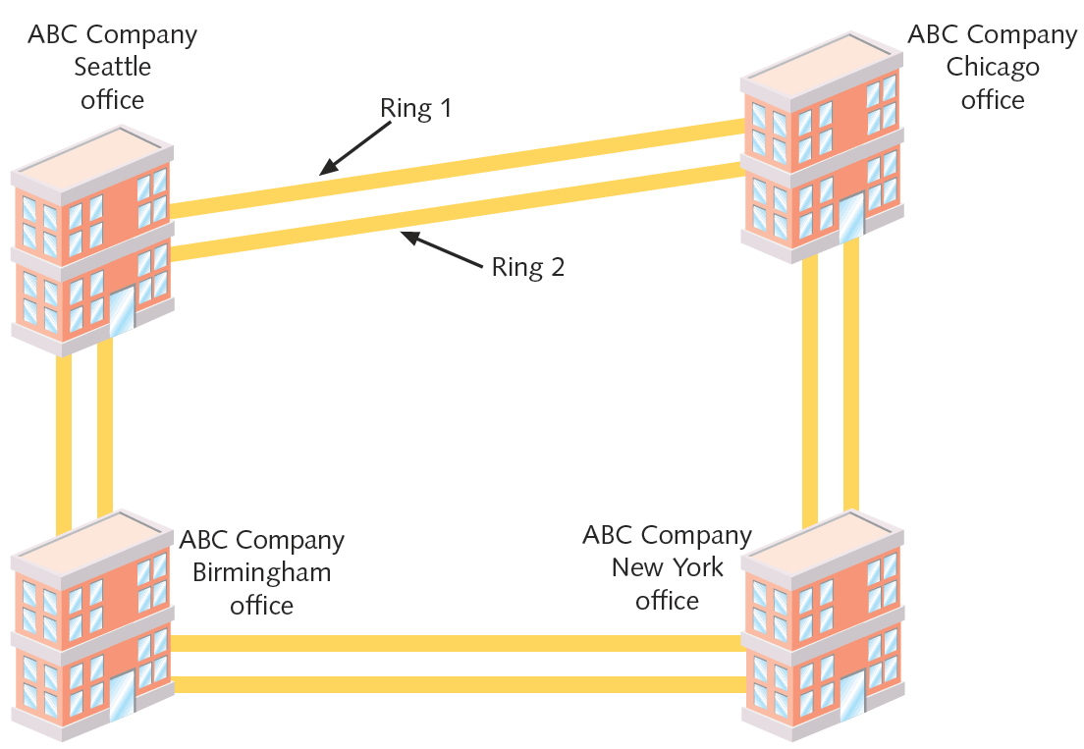
Figure 7-23 A SONET ring
Courtesy Course Technology/Cengage Learning

Slide 67
SONET (cont’d.)
Fault tolerance
Double-ring topology over fiber-optic cable
SONET ring
Begins, ends at telecommunications carrier’s facility
Connects organization’s multiple WAN sites in ring fashion
Connect with multiple carrier facilities
Additional fault tolerance
Terminates at multiplexer
Easy SONET ring connection additions, removals

Slide 68
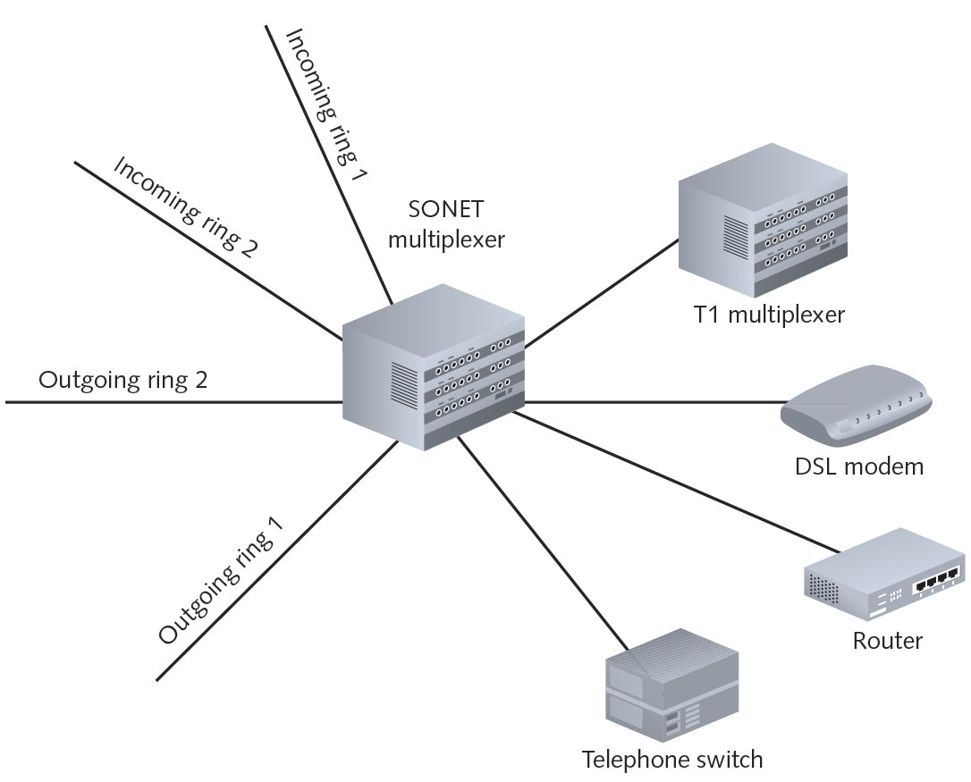
Figure 7-24 SONET connectivity
Courtesy Course Technology/Cengage Learning

Slide 69
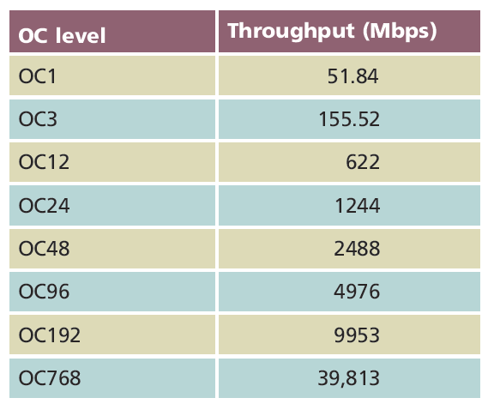
SONET (cont’d.)
Data rate indicated by OC (Optical Carrier) level
Table 7-3 SONET OC levels
Courtesy Course Technology/Cengage Learning

Slide 70
SONET (cont’d.)
Implementation
Large companies
Long-distance companies
Linking metropolitan areas and countries
ISPs
Guarantying fast, reliable Internet access
Telephone companies
Connecting Cos
Best uses: audio, video, imaging data transmission
Expensive to implement

Slide 71
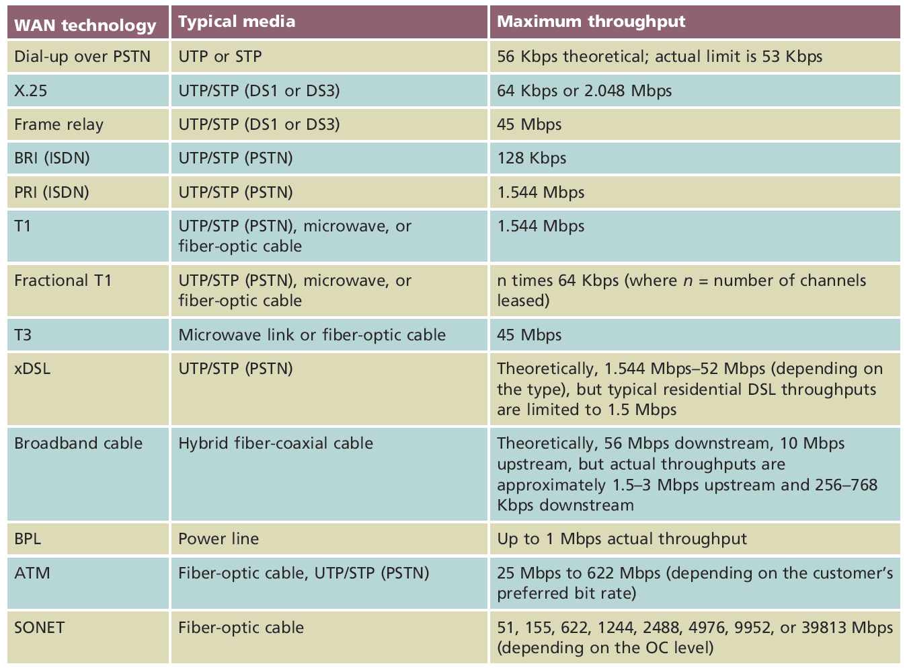
WAN Technologies Compared
Table 7-4 A comparison of WAN technology throughputs
Courtesy Course Technology/Cengage Learning

Slide 72
Summary
WAN topologies: bus, ring, star, mesh, tiered
PSTN network provides telephone service
FTTP uses fiber-optic cable to complete carrier connection to subscriber
High speed digital data transmission
Physical layer: ISDN, T-carriers, DSL, SONET
Data Link layer: X.25, frame relay, ATM
Physical and Data link: broadband

